Slide 1
Office Computer Application WEEK TEN
Muhammad Unggul Pamenang

Slide 2
Please Do It With MS Excel from 2010 - 2016

Slide 3
Getting Started with Excel
1
MS Excel 2016

Slide 4
Introduction
Excel is a spreadsheet program that allows you to store, organize, and analyze information. While you may believe Excel is only used by certain people to process complicated data, anyone can learn how to take advantage of the program's powerful features. Whether you're keeping a budget, organizing a training log, or creating an invoice, Excel makes it easy to work with different types of data.

Slide 5
Getting to know Excel
If you've previously used Excel 2010 or Excel 2013, then Excel 2016 should feel familiar. If you are new to Excel or have more experience with older versions, you should first take some time to become familiar with the Excel interface.

Slide 6
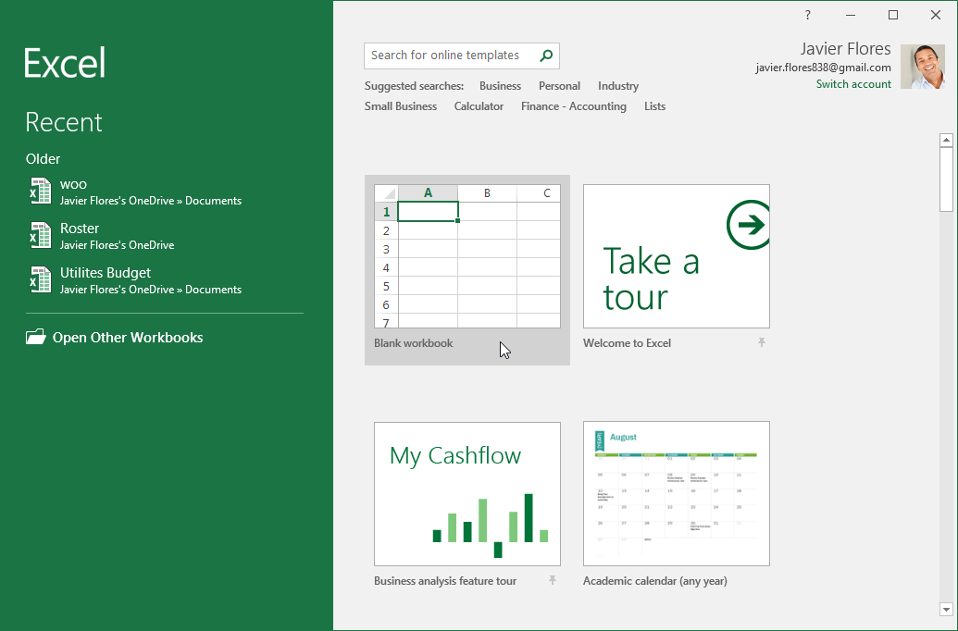
The Excel interface
When you open Excel 2016 for the first time, the Excel Start Screen will appear. From here, you'll be able to create a new workbook, choose a template, and access your recently edited workbooks.
From the Excel Start Screen, locate and select Blank workbook to access the Excel interface.

Slide 7
Working with the Excel environment
The Ribbon and Quick Access Toolbar are where you will find the commands to perform common tasks in Excel. The Backstage view gives you various options for saving, opening a file, printing, and sharing your document.

Slide 8
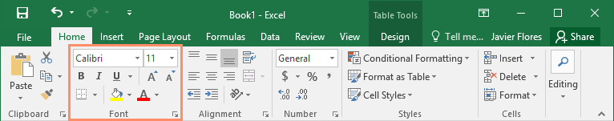
The Ribbon
Excel 2016 uses a tabbed Ribbon system instead of traditional menus. The Ribbon contains multiple tabs, each with several groups of commands. You will use these tabs to perform the most common tasks in Excel.
Each tab will have one or more groups.

Slide 9
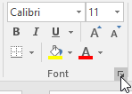
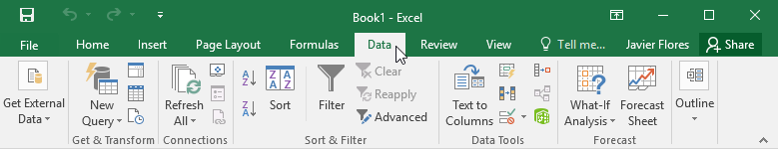
The Ribbon
Some groups will have an arrow you can click for more options.
Click a tab to see more commands.

Slide 10
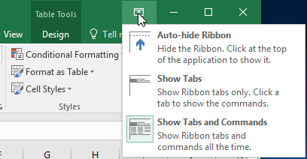
The Ribbon
You can adjust how the Ribbon is displayed with the Ribbon Display Options.

Slide 11
The Quick Access Toolbar
Located just above the Ribbon, the Quick Access Toolbar lets you access common commands no matter which tab is selected. By default, it includes the Save, Undo, and Repeat commands. You can add other commands depending on your preference.

Slide 12
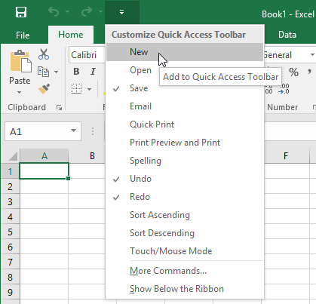
To add commands to the Quick Access Toolbar:
Click the drop-down arrow to the right of the Quick Access Toolbar.
Select the command you want to add from the drop-down menu. To choose from more commands, select More Commands.

Slide 13
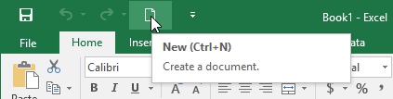
To add commands to the Quick Access Toolbar:
The command will be added to the Quick Access Toolbar.

Slide 14
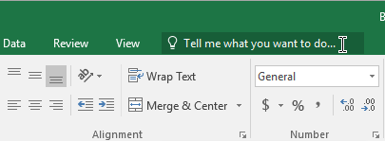
How to use Tell me:
The Tell me box works like a search bar to help you quickly find tools or commands you want to use.

Slide 15
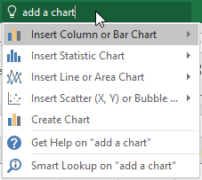
How to use Tell me:
Type in your own words what you want to do.

Slide 16
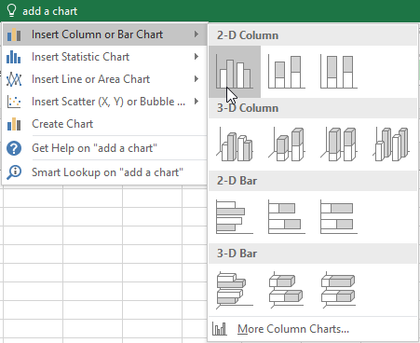
How to use Tell me:
The results will give you a few relevant options. To use one, click it like you would a command on the Ribbon.

Slide 17

Worksheet views
Excel 2016 has a variety of viewing options that change how your workbook is displayed. These views can be useful for various tasks, especially if you're planning to print the spreadsheet. To change worksheet views, locate the commands in the bottom-right corner of the Excel window and select Normal view, Page Layout view, or Page Break view.

Slide 18
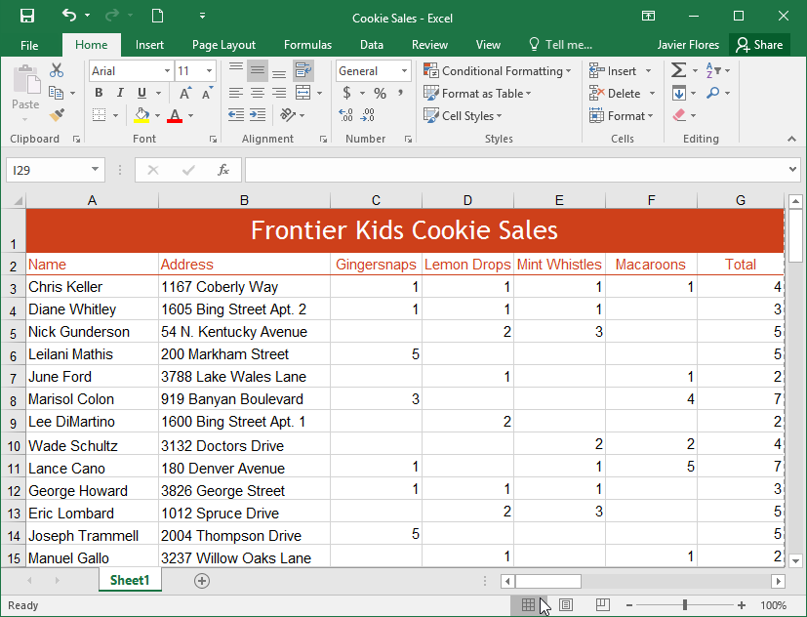
Worksheet views
Normal view is the default view for all worksheets in Excel.

Slide 19
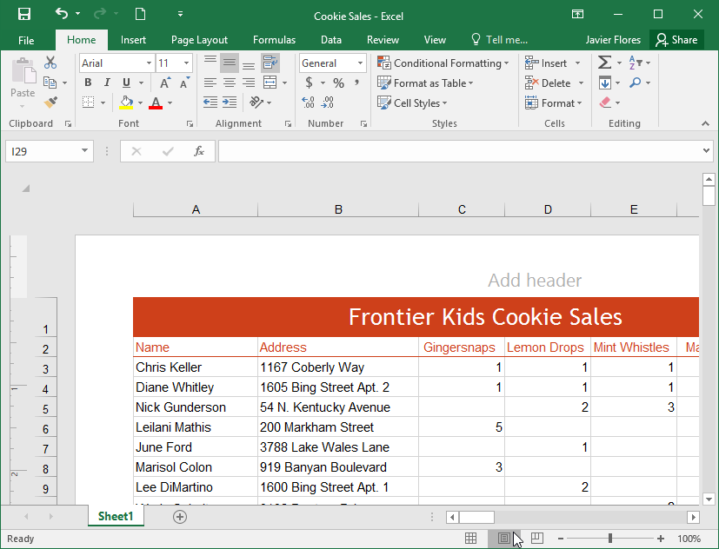
Worksheet views
Page Layout view displays how your worksheets will appear when printed. You can also add headers and footers in this view.

Slide 20
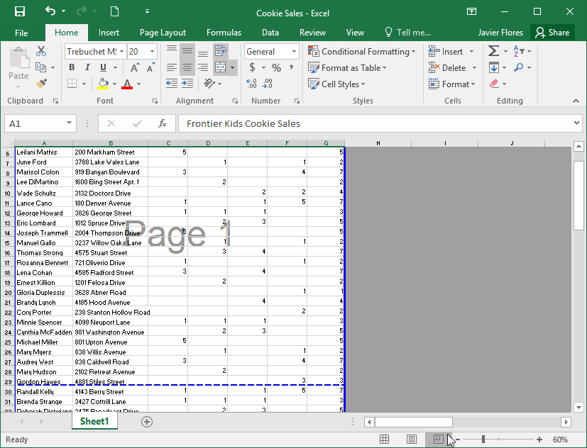
Worksheet views
Page Break view allows you to change the location of page breaks, which is especially helpful when printing a lot of data from Excel.

Slide 21
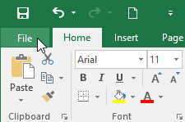
Backstage view
Backstage view gives you various options for saving, opening a file, printing, and sharing your workbooks.
To access Backstage view:
Click the File tab on the Ribbon. Backstage view will appear.

Slide 22
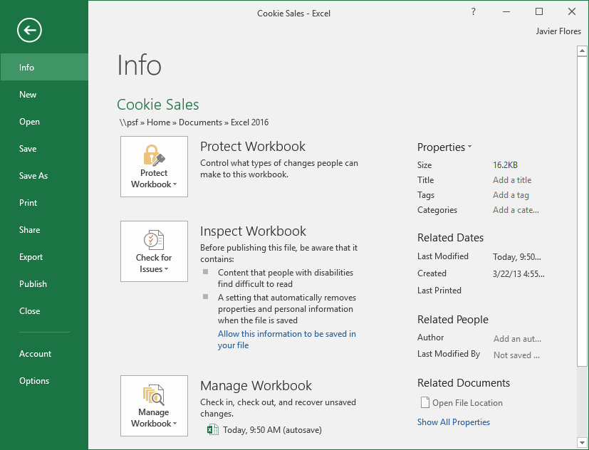
Backstage view

Slide 23
JOBSHEET
Continue working

Slide 24
THANKS!

